Slide 1

Boeing Cabin Experience
-The Development Team-
Paige Webber
Cole Donovan
Nicholas Mooney
Win Todd

Slide 2

about the NDA and a word about what will be demonstrated relative to the NDA

Slide 3

Project Overview
What is this application supposed to help with and accomplish?
Relay data in real time during flight tests, while the flight is in the air
How are we going to make this happen...?

Slide 4


WHAT IS THE SSA?
PROGRESS SO FAR...
Coming up after the SSA demo: WHAT IS THE FTA?

Slide 5
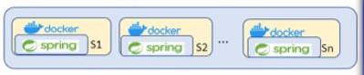
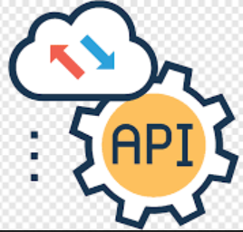
THE SSA (SERVICE SIMULATOR APPLICATION)
3 API services
APIs need to be containerized
127 endpoints total

Slide 6
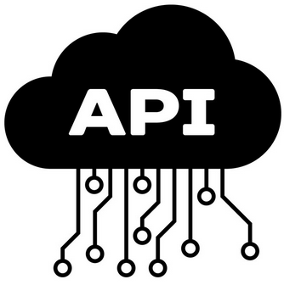
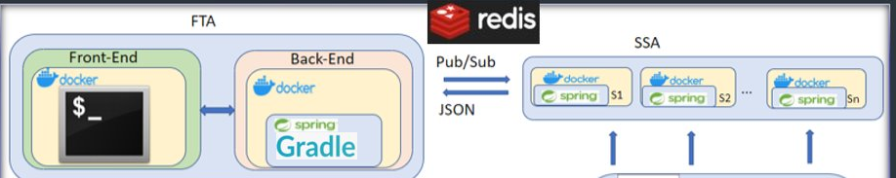
WHAT HAS HAPPENED SO FAR...
An SSA that simulates Boeing data, (with what we were provided), and relays it via Redis (explained later) to the FTA
A front end (the FTA), the user interface that an employee of Boeing will be interacting with.

Slide 7



SSA Progress
Spring Boot servers allow a multitude of API interactions in the same format as Boeings Network
Redis servers allow these mock services to share common data
Redis servers and Spring Boot servers held in deployable containers with docker
Container ports exposed to allow access to service endpoints by FTA

Slide 8

SSA Demo

Slide 9
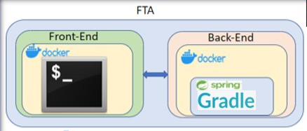

The FTA (Flight Test Application)
REPORT REAL TIME DATA
ALLOW USERS TO REMOTELY ACCESS THE DATA

Slide 10
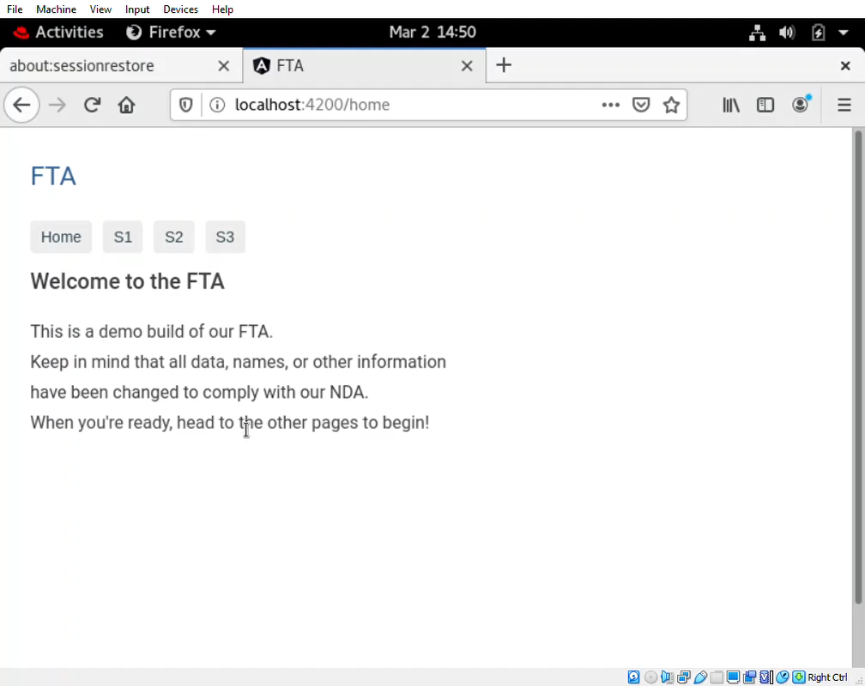
FTA Demo

Slide 11

FTA Progress
Built using Angular web framework
Foundation allowing for expansion
Interfaces with the SSA
Made for use in a keyboard-free environment

Slide 12
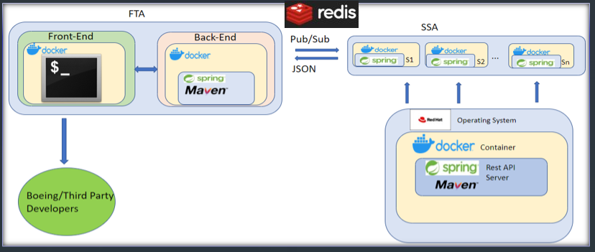

TECH STACK OVERVIEW

Slide 13

A new addition to the tech stack
Deployment with Heroku

Slide 14
MILESTONES and BACKLOG
Demoable Milestones​ | Description​​
JSON Server Responses​​ | Simple API sever that is dockerized and can be invoked to generate data and return in Json​
Conforms to Boeing API ​ | Conforms to same Data and API as Airplane Info Systems​​
SSA Completion​ | Mimics data the airplane Info system provides​ and is configurable and documented​
Displays Troubleshooting Logs​​ | Visibly formats logs from the server for debugging​​
Parsing Troubleshooting​ Logs​​ | Able to search for specific logs by type or time​​
Fault / Error Processing​​ | Accept and publishes errors to the user based on logs​​
Configuration Settings​​ | Able to change and view settings for SSA and FTA as well as installed software​​

Slide 15
sprint release plan
(From the end of the semester)
Sprint | Sprint goal | backlog | Demo
Sprint 1 | Baseline API for SSA responses | 1, 2 | Simple API sever
Sprint 2 | Several containerized service simulators within the SSA | 1 | Populated data responses
Sprint 3 | Implement SSA with PubSub modeling | 1, 13 | Shared PubSub data between services
Sprint 4 | Configuration of data generation according to JSON load file | 13 | Configuration for data generation.
Sprint 5 | FTA Log displays shown in real-time | 12 | Realtime display of logs
Sprint 6 | Active troubleshooting with log parsing | 11 | Will show ability to parse logs by log time or log type i.e. error, warning, or service
Sprint 7 | Enable fault reporting and health monitor display | 3, 5, 7 | View health and faults of simulated hardware
Sprint 8 | Develop thread details, port controls and displays, config Reports | 6, 4, 8 | View thread details and port control displays
Sprint 9 | Reporting on logs, configurations, and container monitoring | 9, 10 | Download various reports and view configurations, and containers
Sprint 10 | Front End UI (stretch goal) Implement better version of UI | 14 | View a better UI with proof of same functionality

Slide 16




sprint release plan
(Changes)
Sprint | Sprint goal
Sprint 1 | Baseline API for SSA responses
Sprint 2 | Several containerized service simulators within the SSA
Sprint 3 | Implement SSA with PubSub modeling
Sprint 4 | Configuration of data generation according to JSON load file
Sprint 5 | FTA Log displays shown in real-time
Sprint 6 | Active troubleshooting with log parsing
Sprint 7 | Enable fault reporting and health monitor display
Sprint 8 | Develop thread details, port controls and displays, config Reports
Sprint 9 | Reporting on logs, configurations, and container monitoring
Sprint 10 | Front End UI (stretch goal) Implement better version of UI
Sprint | Sprint goal
Sprint 1 | Baseline API for SSA responses
Sprint 2 | Several containerized service simulators within the SSA
Sprint 3 | Implement SSA with PubSub modeling
Sprint 4 | Configuration of data generation according to JSON load file
Sprint 10+ | FTA Baseline and deployability for Project
Sprint 8 | Develop thread details, port controls and displays, config Reports
Sprint 7 | Enable fault reporting and health monitor display
Sprint 5 | FTA Log displays shown in real-time
Sprint 6 | Active troubleshooting with log parsing
Sprint 9 | Reporting on logs, configurations, and container monitoring

Slide 17

Risks
Unable to meet the scope
Personal health
Technical issues

Slide 18

How we divided work
All doing the same work
Working in groups of separately
Trouble with documentation
Heroku
Project Management Considerations

Slide 19


